Slide 1
North Carolina State highway Patrol

Slide 2
Weigh in Motion Technology
Autonomous Truck Weigh Station By-Pass
FHWA Size and Weight Plan
Violation Notification Test Location
Creative Use of Screening Tools (WIM)

Slide 3

Autonomous Truck Weigh Station By-Pass

Slide 4


Slide 5
2026 Size and Weight Plan
The North Carolina State Highway Patrol Weigh Station By-Pass
Will allow fully autonomous commercial motor vehicles to by-pass weight stations with or with out violations.
Will build a violation notification system.

Slide 6
Current Screening Process
Thousands of trucks are screened daily. It is impossible to stop all trucks that have violations.
Currently the company does not know if we detected a violation unless we pull the truck over for an inspection or weight check.
Does the “lack of action” by a state cause liability to the state?
Can a company be held liable if they were not made aware of the violation that was detected?

Slide 7
Violation Notification
The State of North Carolina is going to build a system that will notify the carrier of a detected violation.
The system will be used for autonomous CMV’s and CMV’s trucks.
If the company is in compliance with the Enhanced Inspection Program, autonomous vehicles will be allowed to by-pass the weigh station.
If a violation is detected the company will be notified of the possible violation and they will be expected to correct the issue before returning to North Carolina.

Slide 8
Weigh Station Feasibility Studies
The first study was completed in 2004
This study recommended closing most of our small weigh stations and replacing them with much larger weigh stations. NC built one new weigh station near Charlotte.
A second study was completed in 2022
This study recommended utilizing by-pass technology to make the small weigh stations more efficient and did not recommend closing them.

Slide 9
Creative use of Technology
Hendersonville North Carolina
One of our small weigh stations lost most of its parking lot due to an interstate widening project.
The effect on the weigh stations was not addressed prior to the approval of the project.
We had to create a solution to prevent the closure of the weigh station.

Slide 10
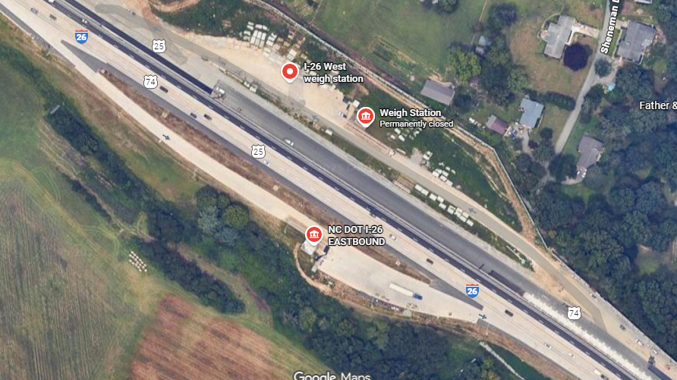

Slide 11
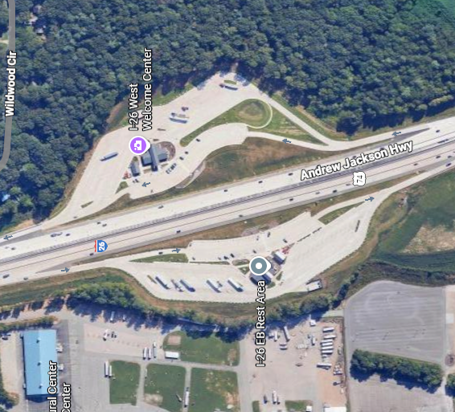

Slide 12
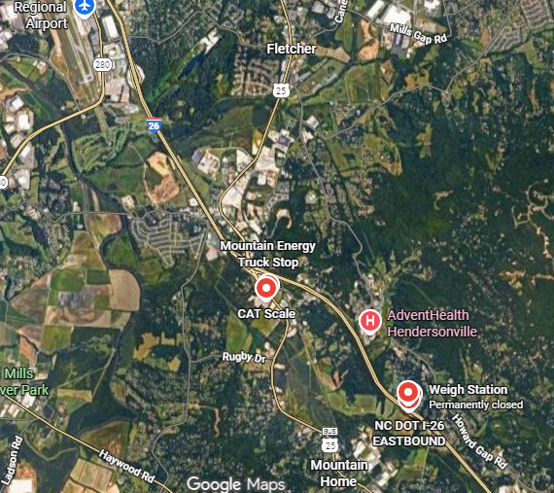

Slide 13
Quarterhill Concept Drawing

Slide 14
Solution Integrate the Welcome Centers with the Weigh Stations
Troopers will be able to sit inside the Welcome Center and monitor the “Weigh Station/Virtual Weigh Station”.
If they see a truck that they want to inspect they can direct the truck to enter the Welcome Center.
The Trooper will have plenty of room inside the truck parking at the Welcome Center to conduct truck inspections. We even have access to the fair grounds parking lot to place out of service trucks.

Slide 15
Questions??
Kendell Jackson
336 488-8014
Kendell.jackson@ncshp.gov

