Slide 1
Safety Assessment of Reinforced Concrete Highway Bridges for Overloading Vehicles Using Weigh-In-Motion (WIM) Data By Binyam Wesenseged

Slide 2
Introduction 1.1 Aim and objectives of the study
Aim
To assess the existing current load model evidence based Ethiopian context
Overview of overloading issues in highway bridges
Importance of structural safety assessments
Role of Weigh-In-Motion (WIM) technology in bridge evaluations

Slide 3
Introduction 1.1 Aim and objectives of the study
Objective :
To show the application of different statistical tools to make the analysis
Critical analysis loading situations imposed by traffic, moments and shear forces induced in several types of bridge configurations.
To develop appropriate software to make simulations on a huge database.
Assess impact of overloading on reinforced concrete bridges
Utilize WIM data to enhance live load models
Provide policy recommendations for infrastructure management

Slide 4
Introduction 1.2 Research Scope
WIM Calibration: Ensuring data accuracy to minimize errors in weight measurement.
Load Analysis: Assessing traffic patterns and axle configurations to determine realistic load effects.
Structural Reliability Assessment: Investigating bridge stress under excessive loads and identifying critical vulnerabilities.
Policy Recommendations: Developing strategies for enforcement, regulation, and long-term infrastructure resilience.
Importance of WIM in Bridge Engineering
WIM enables real-time monitoring of vehicle weights, reducing reliance on manual weighing stations.
Identifies overloaded vehicles that contribute to premature bridge deterioration.
Supports predictive maintenance strategies, reducing long-term costs and improving infrastructure sustainability.

Slide 5
1.3 Methodology
WIM data collected from Addis-Adama Expressway over five years, covering more than 45,000 truck loadings.
Statistical analysis, including extreme value theory (EVT), to estimate critical loading conditions.
Finite Element Analysis (FEA) used to simulate bridge response to real-world loading scenarios.
Comparative evaluation against AASHTO LRFD and Ethiopian Road Authority (ERA) standards.

Slide 6
1.3.2 WIM Data Collection
Location: Addis-Adama Expressway, a critical corridor for freight transport.
Dataset: Over 45,000 heavy truck loadings recorded, providing a robust sample of live traffic loads.
Parameters: Axle loads, vehicle weights, axle spacing, and headway between vehicles.
Data Processing and Quality Control
Erroneous and inconsistent data points removed to ensure accuracy.
Calibration and validation of WIM sensors performed regularly to maintain reliability.
Standardized methodologies followed for data cleaning and quality control.

Slide 7

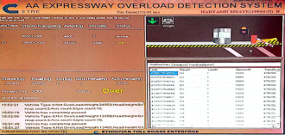

1.3.2 WIM Data Collection (cont...)
Data Collection Area
.
Overloading Detection System
Vehicle Classes and symbols

Slide 8

1.4 Cleaning (Filtration) of Unreliable WIM Data
The cleaning techniques used in this work by prominent authors (Enright and O’Brien, 2011; Getachew, 2003; Sivakumar et al., 2011, Xiao Yi Zhou, 2013) are presented in Table below:

Slide 9


Slide 10
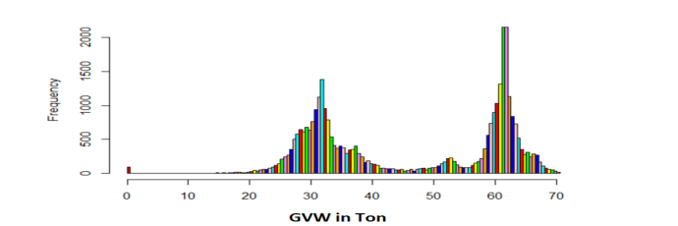
2. General Statistical Properties of the WIM Data
The histogram plot of the gross vehicle masses which is shown in Figure below, displays a twin-peaked bimodal distribution of gross vehicle mass ranging from 11 ton to 70 ton.
The first mode contains mostly the 3 axle vehicles and partially loaded vehicles which are above the three axles. The second mode involves the fully loaded 4 to 7 axle vehicles.

Slide 11
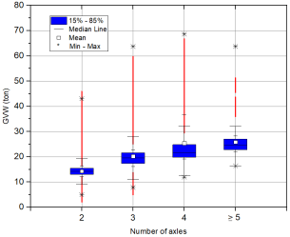
2.1 OVERLOADING
The extent of overloading present on the roads from the data given was analyzed to give insight to the extent in which overloading was occurring.
The number of illegal vehicles violating national laws is shown. The table indicates that, regarding the front axle and GVW, 43.59% and 5.92% of vehicles exceed the national limit, respectively. Therefore, the regulating authority should control GVW and each axle load, particularly the front axle
No. of axles | No. of Vehicles | Overloaded front axle (limit=8 ton) |  | Overloaded or illegal vehicles (National law, Negarit)
 |  | No. | % | GVW, limit (ton) | No. | %
2 | 34,537 | 14,488 | 41.95 | 18 | 1,831 | 5.30
3 | 6,163 | 3,265 | 52.98 | 28 | 338 | 5.48
4 | 3,468 | 1,844 | 53.17 | 38 | 503 | 14.50
> 5 | 1,029 | 106 | 10.30 | 46+ | 4 | 0.38
 | 45,197 | 19,703 | 43.59 |  | 2,676 | 5.92

Slide 12



Overloaded Vehicles which were observed during site visit

Slide 13
3 Statistical Distributions
As known, live loads are random variables that depend on time. So, a theoretical distribution function could be best fitted to the observed set of events. In this study, by using theoretical distributions, it is able to predict extreme events with a given probability of exceedance. The distributions of the load effects are observed to follow different types of distributions depending on the bridge lengths and load effects. The main purpose of fitting statistical distribution is to define the type of the parent load effect distributions
Statistical Distributions for Moment
Span | Statistical Distribution | Span | Statistical Distribution
5m | Normal | 30m | Gama
10m | Log-Normal | 35m | Gumbel
15m | Log-Normal | 40m | Gumbel
20m | Normal | 45m | Gumbel
25m | Gama | 50m | Gumbel

Slide 14
Statistical Distributions for Shear
Span | Statistical Distribution | Span | Statistical Distribution
5m | Gama | 30m | Normal
10m | Log-Normal | 35m | Normal
15m | Gama | 40m | Normal
20m | Normal | 45m | Normal
25m | Normal | 50m | Normal
(a)
(b)
Q-Q plots for 35m (a) shear force and (b) bending moment

Slide 15
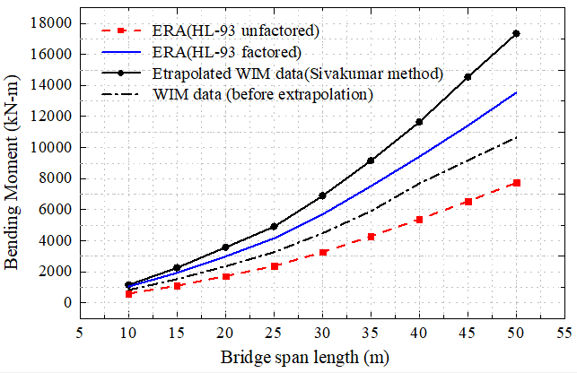
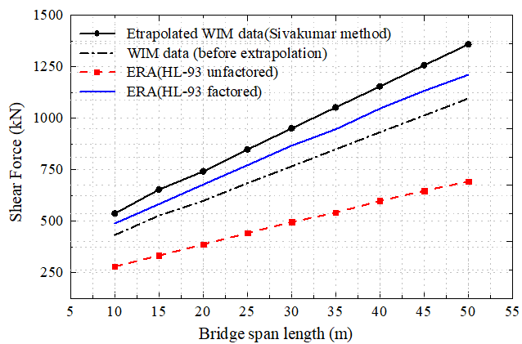

4. Extrapolation using Different Extrapolation Techniques
Three case scenarios were taken on the selection of the population size,
The block size was taken in a time frame of a month
Castillo approach which fit the top 2$\sqrt{n}$ of distribution of n data.
Enright fitting of the top 30% of the data and is compared for different spans.
Plot of extrapolated Bending Moment and Shear using Normal Distribution

Slide 16
4.1 Key Findings - Load Underestimation
WIM data shows that actual truck loads exceed factored HL-93 design loads by 15%.
Indicates that current design models may underestimate bridge loading, leading to potential safety risks.
Key Findings - Bridge Safety Concerns
40% of assessed bridges have a load rating factor below 1.0, indicating structural vulnerabilities.
Continuous overloading increases the risk of cracking, fatigue, and long-term deterioration.
Bridges under heavy truck corridors require reevaluation and reinforcement strategies.

Slide 17
4.2 Alternative Live Load Models
Proposed WIM-based models reduce error margins to <9.48%, providing more accurate predictions.
Load factors calibrated using real-world truck traffic, improving reliability of bridge designs.
Policy Recommendations
Enforce stricter weight regulations to prevent excessive truck loading.
Establish national calibration standards for WIM systems to improve measurement consistency.
Integrate real-time WIM monitoring into transportation infrastructure planning.
Impact on Infrastructure Resilience
Improved bridge safety through data-driven assessment models.
Reduction in maintenance costs by identifying at-risk bridges before significant damage occurs.
Strengthened regulatory framework for vehicle weight enforcement.

Slide 18

4.2 Alternative Live Load Models
Based on the output of the simulation results, mean load factors for shear force and bending moment of 1.98 and 2.12 with standard deviations of 0.02 and 0.09 are computed, respectively. These results exceed the limit of the load factor of 1.75 specified in LRFD bridge design codes . Hence, in this research, four alternative options are proposed for highway bridges design:
Option-1: It is proposed to replace the HL-93 load model with the new live load model shown in Fig. In this case a load factor of 2.0 and a headway distance of 12 m are to be used.
Option-2: The second proposal makes the assumption that the AASHTO/ERA HL-93 live load model will remain unchanged while a load factor is increased to 2.0 for shear force and 2.10 for bending moment.
Option-3: This option suggests to use the HL-93 load model with a modification of lane load. Instead of 9.3 kN/m², lane loads of 13 kN/m² and 15.5 kN/m² are to be used for shear force and bending moment computations, respectively. In this case, load factor of 1.75 as recommended in AASHTO and ERA is to be used for both shear force and bending moment

Slide 19
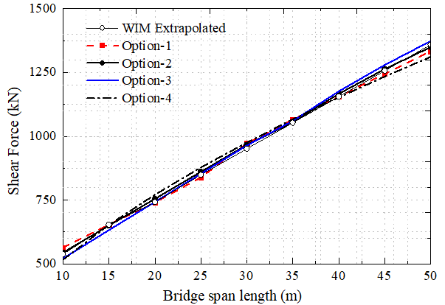
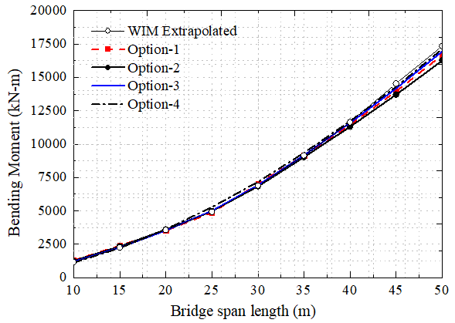
4.3 Comparison of WIM extrapolated data with proposed options
Comparison between the suggested options and the WIM extrapolated data is made and the results are presented in Fig As illustrated in Fig all of the proposed options fit the WIM extrapolation data with errors below 4.82% for shear force and 9.48% for bending moment. This analysis emphasizes the significance of using appropriate live load models and changing load factors to achieve structural safety in highway bridge design.
Comparison of proposed options with WIM extrapolated data
(a) shear force and (b) bending moment

Slide 20
5. Conclusion and Recommendations 5.1 Conclusion
Study confirms that overloaded vehicles significantly impact bridge durability.
WIM technology provides a reliable approach for assessing real-world traffic loads.
Implementation of refined live load models can improve infrastructure sustainability and safety.

Slide 21
6. Recommendation's
Establish WIM-based weight enforcement checkpoints at critical locations.
Strengthen collaboration between researchers, transportation agencies, and policymakers.
Develop predictive models using machine learning for future traffic load forecasting.
Expand WIM data collection beyond major highways to rural and secondary roads.
Utilize AI-driven predictive modeling to improve load forecasting accuracy.
Conduct long-term monitoring of bridge health using integrated sensor networks.

Slide 22

Thanks!

