Slide 1



Protecting roads and bridges with bridge weigh-in-motion
Matija Mavrič
Head of Sales & Marketing
matija.mavric@cestel.si
Notes:
My name is Matija Mavrič. I currently serve as the Head of Sales and Marketing, and I've been with the company for over 25 years.
I won’t go into a detailed introduction of Cestel today, as I believe most of you are already well familiar with us.
What’s important to highlight is that we've been the leading force in the field of Bridge Weigh-in-Motion (B-WIM) technology for nearly 30 years.

Slide 2
Agenda
Facts.
About Structural Bridge WIM diagnostic system.
Use cases.

Slide 3

Challenges facing infrastructure
Lack of public funding
Aging roads and bridges
Global warming
Notes:
What are Challenges facing infrastructure …
Lack of public funding…?
Aging roads and bridges?
Others?... These are known facts that we cannot avoid, that we are aware of, and that we must face in the best possible way

Slide 4
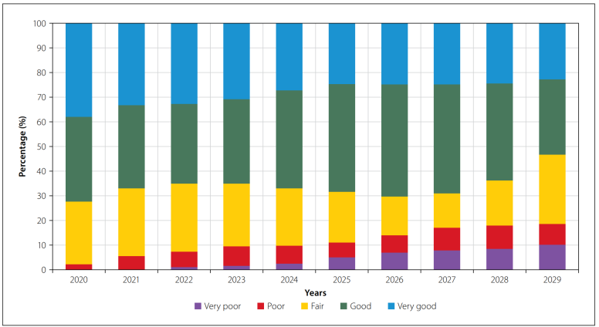
Cape Town, predicted road condition
Figure: City of Cape Town predicted condition deterioration with no change in maintenance budget allocation (Source: SAICE 2022 Infrastructure Report Card for South Africa)
Notes:
This graph shows how the condition of infrastructure in Cape Town is expected to get worse from 2020 to 2029 if the maintenance budget stays the same.
Over time, the amount of infrastructure in "Very Good" condition goes down, while the parts in "Poor" and "Very Poor" condition increase.
By 2029, a large part will be in bad shape.
The message is clear: without more investment in maintenance, the overall condition will continue to decline, leading to higher repair costs in the future.

Slide 5
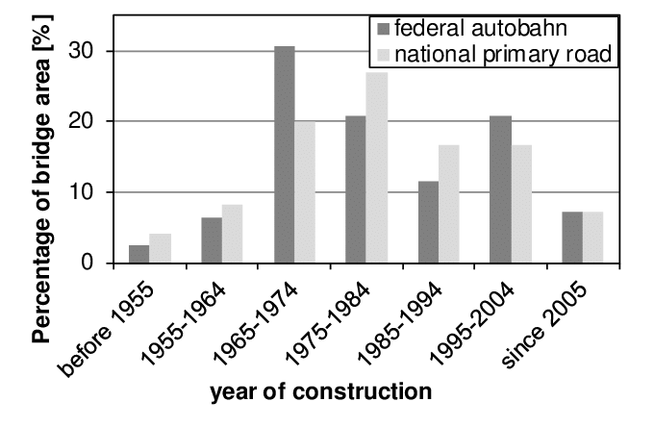
Aging bridges
USA: 42% of all bridges are at least 50 years old
Germany:
Notes:
Bridges are aging — globally, their average age is around 50 years.
In the United States, 42% of all bridges are at least 50 years old.
Official data from Germany shows that 10% of bridges were built before 1964, and more than 30% before 1974, which is quite similar to the situation in
the U.S. This trend has been highlighted for some time by infrastructure experts, and it is expected to become a major challenge for asset managers in
the coming years.

Slide 6
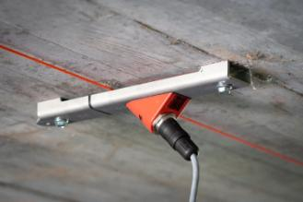
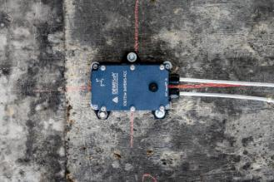
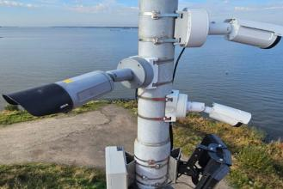
Structural bridge WIM Diagnostics
Structural Bridge WIM Diagnostic system
Bridge WIM | SHM | Peripheral devices
Traffic data | Live monitoring of the bridge | ANPR/overview photos
Structural data | Structural analysis | Dangerous goods detection, light vehicle detection, etc.
Notes:
The Structural Bridge WIM Diagnostic System is divided into three main components:
Bridge WIM
Output: Traffic data and structural data
SHM (Structural Health Monitoring)
Output: Real-time bridge monitoring and structural analysis
Peripheral Devices

Slide 7
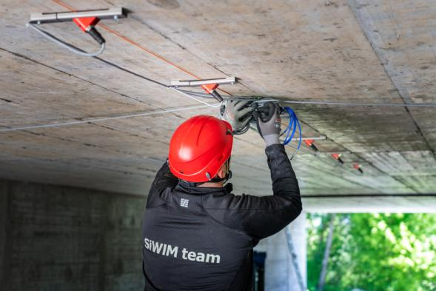
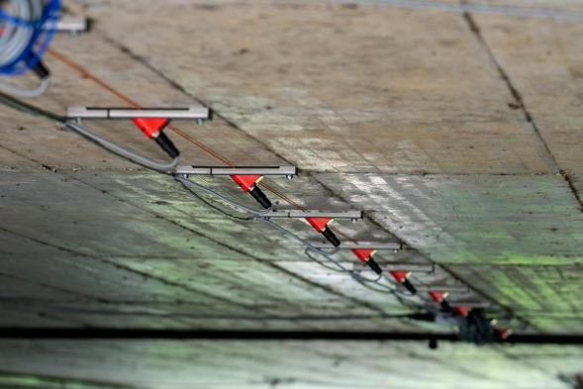
Under the bridge
Notes:
The installation looks like this – simple, under the bridge, completed in a very short time, and most importantly, portability, so easily transferable from one bridge to another.

Slide 8
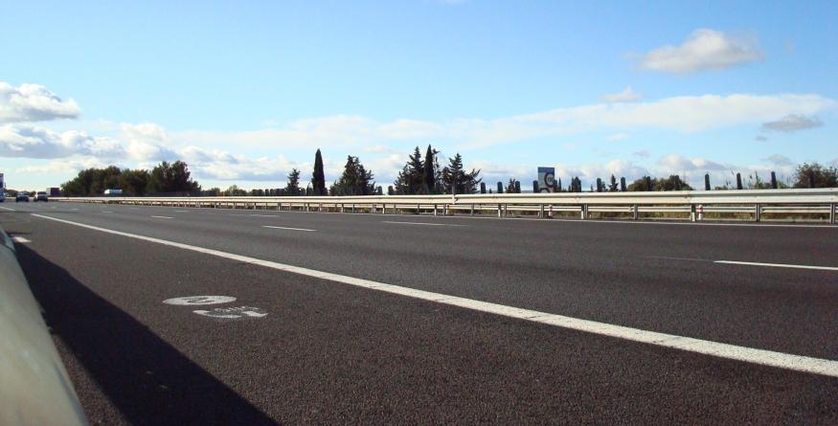
Nothing on the road
Notes:
No roadworks, no lane/road closures, no traffic disruptions during installation or maintenance — this is likely the ideal scenario for any road infrastructure manager.
“Nothing on the road” is a concept our company has embraced for years, and it is equally valuable for the end user.

Slide 9
Collected data
HGV data
Gross weight
Axle loads
Number of axles
Axle distances
Speed
Class/type of vehicle
Driving lane
Time and date
Overview/front photo
Licence plate
Dangerous goods detection
Bridge data
Influence line
Dynamic amplification factor
Girder distribution factor
Bending moments and shear forces
Acceleration
Strain
Frequency
Notes:
What kind of data do we collect?
On one hand, we collect data on heavy goods vehicles. On the other, since the bridge itself functions as a weighing platform, we also gather valuable
information about the bridge structure.
There’s no need to list the vehicle data, as they are the same as with any standard WIM system. What sets our system apart, however, are the structural
data about the bridge—data that conventional WIM systems simply cannot provide. This information is of exceptional value to infrastructure maintenance
teams.
And the best part? It all comes from a single system, at a single location—installed beneath the bridge.

Slide 10
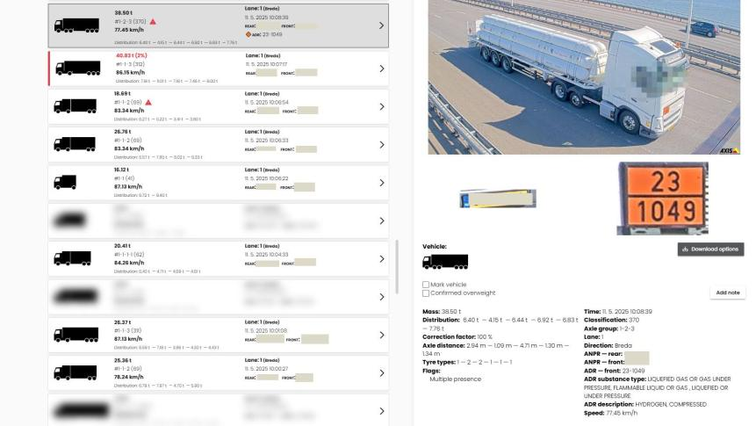
Online app: traffic monitoring
Notes:
Two applications are available for users to monitor and manage live traffic.
The first is dedicated to monitoring heavy goods vehicles. It provides standard WIM system data such as:
– total vehicle weight
– axle loads
– speed
– vehicle classification
– front and rear license plate numbers
– ADR classification
– and more.

Slide 11
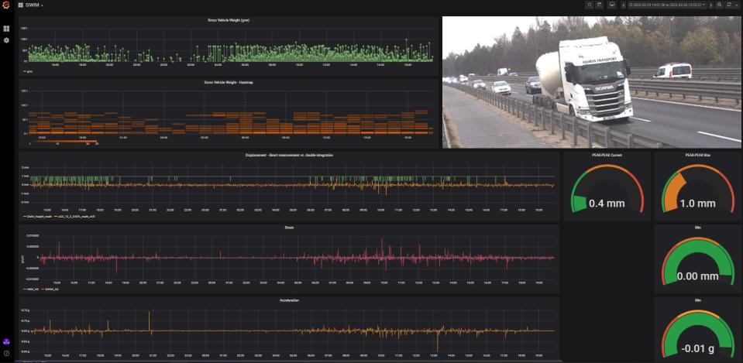
Online app: SHM
Notes:
The second application is designed for experts who monitor and analyze the condition of bridges.
This application integrates data from heavy vehicle monitoring with SHM (Structural Health Monitoring) information, such as acceleration measurements
and related parameters.
With this combined view, bridge engineers can easily identify which vehicle—along with its exact weight—caused specific structural responses.

Slide 12
Use case: Slovenia
Notes:
A few recent examples of B-WIM system implementations around the world—let's start with Slovenia.

Slide 13
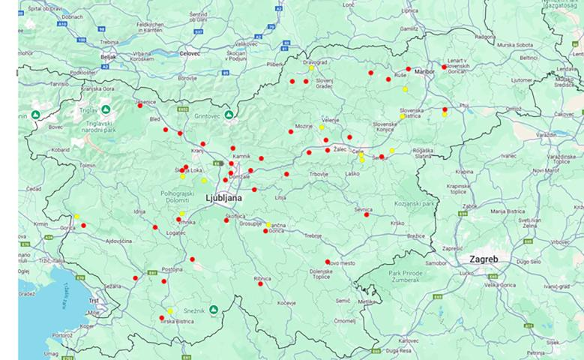
State roads
1-week measurements
1-month measurements
Notes:
On state roads, the Slovenian Infrastructure Agency (DRSI) updates its traffic data records every year—based on a database that has been built
up over the past 25 years.
Each year, approximately 100 B-WIM measurements are carried out at various locations. Some are conducted weekly, others monthly.
The data collected over the last 25 years have significantly contributed to reducing maintenance costs and have played a key role in helping DRSI manage
infrastructure more efficiently.

Slide 14
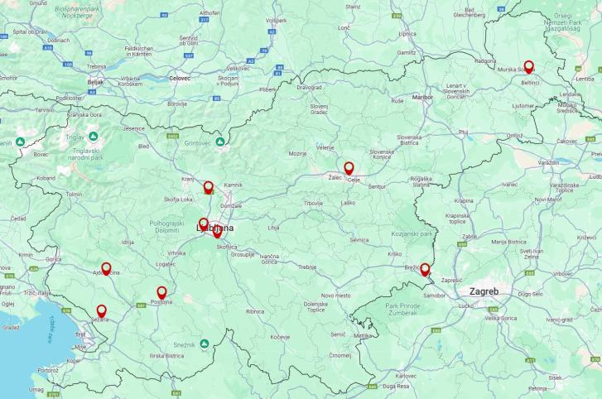
Motorway network
Notes:
We (Slovenia) also perform measurements on expressways and motorways.
Some are short-term, aimed at collecting baseline data. However, on high-traffic transit routes, systems are installed permanently and are relocated every four years as needed.

Slide 15
Marked decrease in overloading
Notes:
The graph shows measurements conducted annually at various locations since 2010, all performed on state roads.
The bold red line represents the annual average, which indicates a decline in the number of overloaded vehicles—despite a significant increase in overall
heavy goods traffic.
This downward trend is the result of continuous monitoring through B-WIM systems, enabling more effective and targeted enforcement by traffic police,
as well as other measures introduced by road authorities.

Slide 16
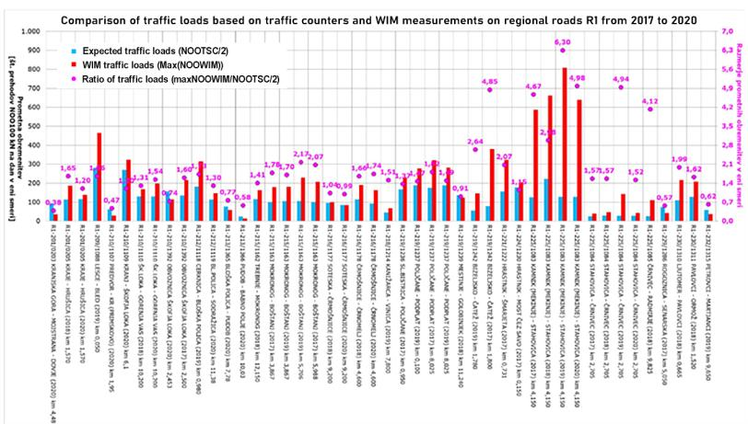
Road design
Notes:
Another graph illustrates the comparison between traffic load data collected by a conventional traffic counter and those measured using the B-WIM system.
In some cases, it becomes evident that traffic counter data can be significantly inaccurate—not due to malfunction or technical error, but because such counters do not account for overloaded vehicles.
These overloads, however, have a considerable impact on the actual stress imposed on a road section and contribute to its accelerated deterioration.

Slide 17
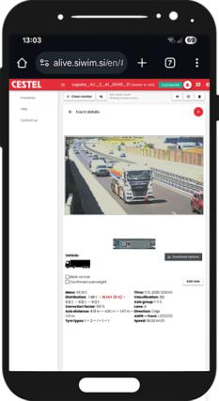
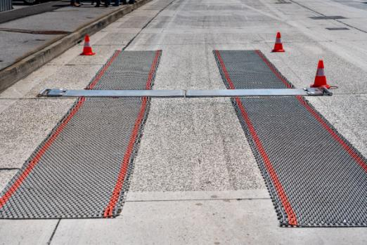
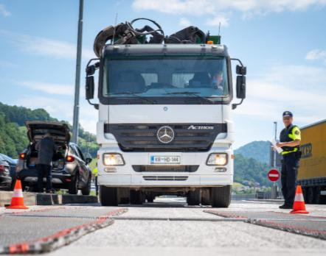
Preselection with portable bridge WIM
Notes:
Another example of portable B-WIM system use.
Years ago, before WIM measurements were introduced in Slovenia, the efficiency rate of traffic police in detecting overloaded vehicles ranged between
10% and 20%. Today, over 90% of stopped vehicles are actually overloaded.
The portability of the B-WIM system plays a key role here, as it allows measurement locations to be changed multiple times per year—greatly increasing
enforcement effectiveness.

Slide 18

Direct enforcement with portable bridge WIM
Notes:
Is direct enforcement based on B-WIM measurements possible?
Yes — especially with the right location strategy.

Slide 19
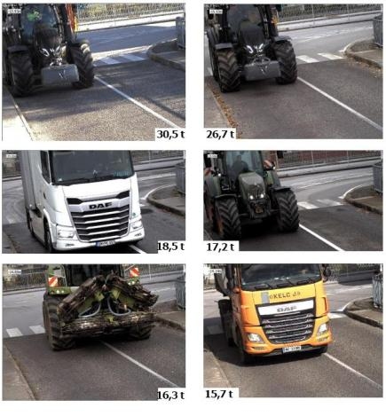
Bridge analysis: GVW limit 3,5 t
Notes:
Another example of portable B-WIM system use.
On a bridge that had a posted total weight limit of 3.5 tons, B-WIM measurements clearly showed that the restriction was being regularly violated in real
traffic conditions.
These findings provided concrete evidence for the authorities, enabling them to take appropriate action—whether through enforcement, structural
assessment, or additional protective measures.

Slide 20
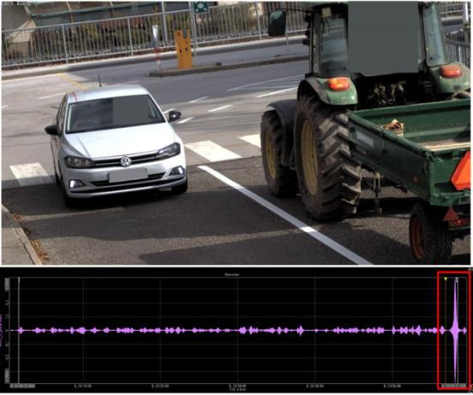
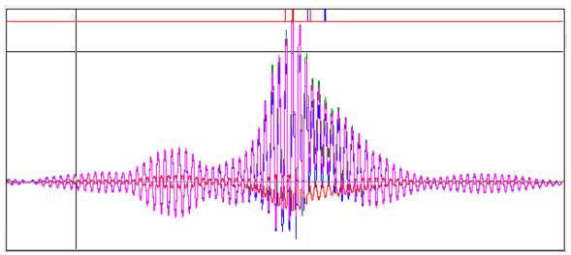
Bridge analysis: bridge dynamics
Notes:
Another example:
Through B-WIM measurements and data analysis, we discovered that overweight vehicles are not the main issue for the bridge structure.
Instead, it’s the lighter vehicles with trailers that pose a greater concern — they generate significantly higher dynamic effects on the bridge.

Slide 21
Use case:
The Netherlands
Notes:
The Netherladns-ongoing project.

Slide 22
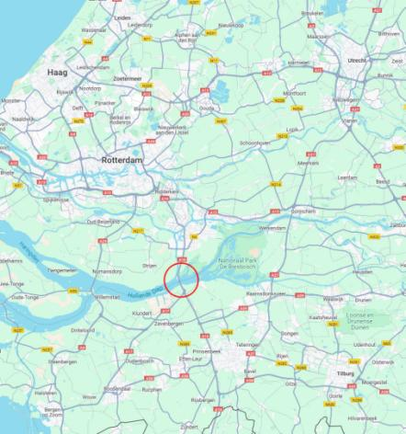
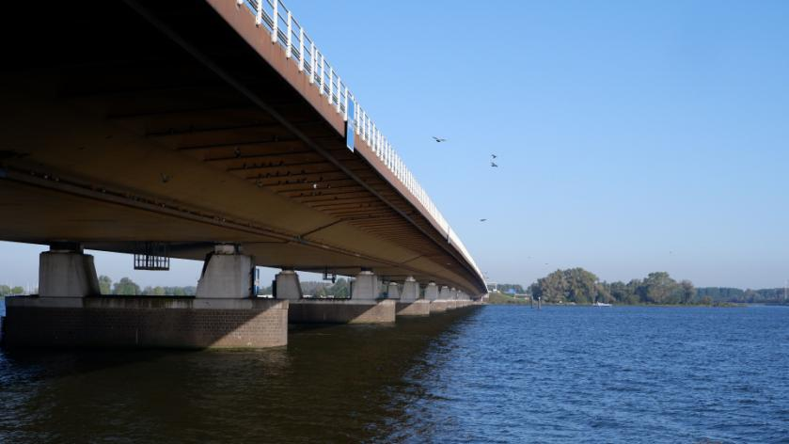
Moerdijk bridge
Notes:
Moerdijk Bridge – 1 km long, used by around 12,000 heavy trucks every day. It connects Rotterdam to southern Europe.
This is one of the most important freight routes in the Netherlands (A16 highway) and a key part of the north-south transport corridor.
Because of its role in European logistics, precise traffic and load monitoring is crucial to keep the bridge safe and plan future maintenance.

Slide 23
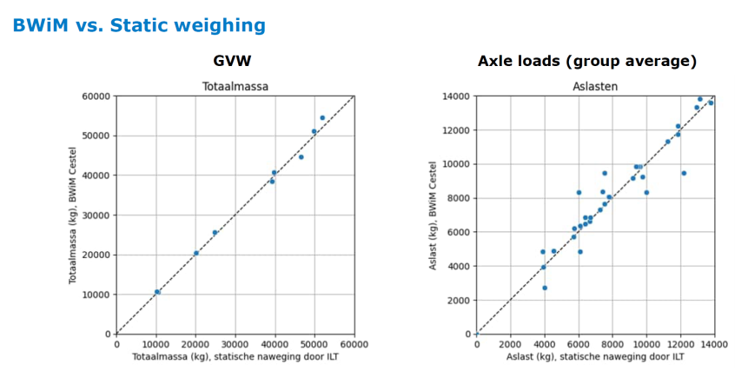
Moerdijk bridge: preselection
BWIM vs. Static weighing
Notes:
The first test conducted by RWS, using vehicles from live traffic, demonstrated high system accuracy—total vehicle weight was within a 5% margin. The client was extremely satisfied with the result.
The system was installed as a pilot project, aimed at analyzing performance, benchmarking it against other systems, and enabling pre-selection of vehicles for further inspection.

Slide 24
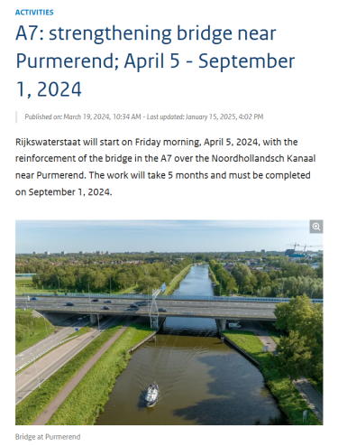
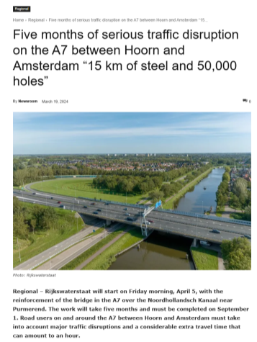
Bridge protection: A7 motorway
Notes:
Shortly after, the next project followed on A7 motorway—this time the measurements were conducted in preparation for bridge renovation.
The contractor specifically requested B-WIM monitoring to ensure the structural safety of the bridge during the works.

Slide 25
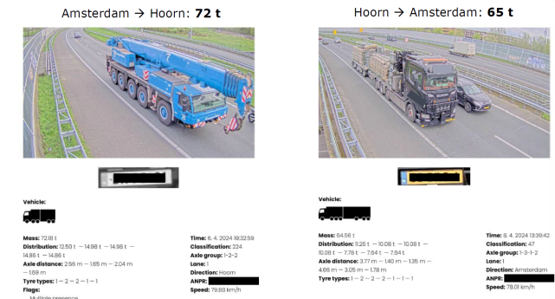
Bridge protection: A7 motorway
Notes:
The posted weight limit was 25 tons, but B-WIM measurements showed that more than 400 overloaded vehicles crossed the bridge every day.
Some of the heaviest cases are shown in the image.
Such frequent overloading can seriously damage the bridge, shorten its lifespan, and increase maintenance costs. Thanks to the B-WIM system, the road authority now has clear data to take action.

Slide 26
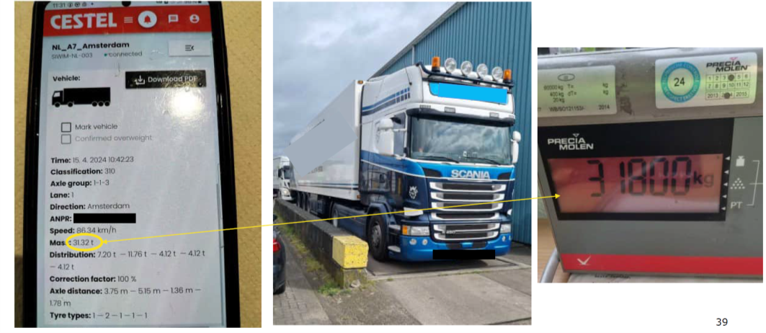
Bridge protection: A7 motorway
Notes:
Some examples of pre-selection results.
On the left: the B-WIM application screen.
On the right: a photo from the weigh station confirming the measurement.

Slide 27
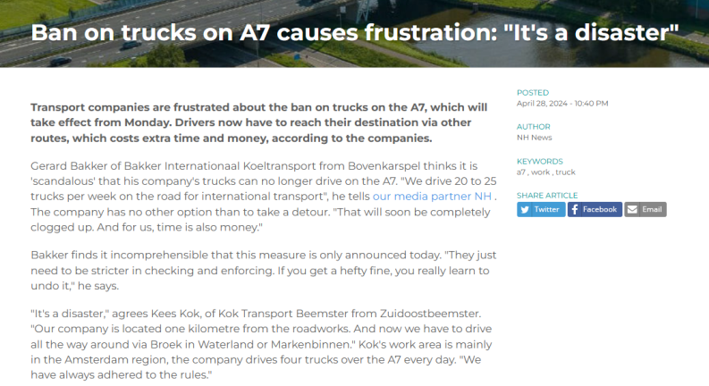
Bridge protection: A7 motorway
Notes:
B-WIM helped make an important decision.
To keep the construction site safe, a full traffic ban had to be put in place.
Because our system is quick to install, doesn't need much equipment, and doesn’t require roadworks or lane closures, the road authority got their first
results just five days after asking for them.
Yes—just five days.
B-WIM played a key role in the decision-making process.
A complete traffic ban was necessary to safely continue with the construction works.
Thanks to quick installation, minimal logistics, no roadworks or lane closures, and the flexibility of our team, the road authority received the first data
within just five days of their initial request.
Let us repeat—within five days.

Slide 28
Sources
SAICE 2022 Infrastructure Report Card for South Africa. Accessed via: https://saice.org.za/downloads/SAICE-2022-Infrastructure-Report-Card.pdf
Bridges - Report Card for America's Infrastructure. Accessed via: https://infrastructurereportcard.org/wp-content/uploads/2020/12/Bridges-2021.pdf

Slide 29

Thank you for your attention
SiWIM you soon!
Notes:
Thank you for your attention and enjoy the rest of the day.

